Slide 1
Telecom Churn Prediction
Team member : Karunakaran R and Dharun RR
Email id :rkarunakaranraja@gmail.com and dharunrio7@gmail.com
Batch : 12th May CDA
Project team id : PTID-CDA-SEP-25-722
Project id : PRCL-0017

Slide 2
Agenda
Introduction
Project Objectives
Dataset Description
Tools & Methodology
SQL Query
Excel Analysis
Model Testing
ML Prediction
Power BI Dashboards
Insights
Recommendations
Conclusion

Slide 3
Introduction
Customer churn refers to the percentage of subscribers who discontinue using a company’s services within a given time period.
In the telecom industry, churn is a critical issue because customer acquisition costs are very high compared to retention costs.
Predicting churn in advance helps telecom companies to identify high-risk customers.
Launch targeted retention campaigns to improve customer satisfaction and reduce revenue loss.
This project applies Machine Learning and Business Intelligence dashboards to predict churn and provide actionable insights.

Slide 4
Project Objectives
Understand factors driving churn.
Create a Churn Risk Score.
Introduce CHURN-FLAG (Yes=1 / No=0) for campaign targeting.
Build dashboards for continuous monitoring.

Slide 5
Dataset Description
The dataset contains 1000 customer data.
Features are State, Account Length, Area Code,
Phone, International Plan, VMail Plan,
VMail Message, Day Mins, Day Calls, Day Charge,
Eve Mins, Eve Calls, Eve Charge,
Night Mins, Night Calls, Night Charge,
International Mins, International calls, International Charge,
CustServ Calls, Churn.

Slide 6
Tools & Methodology
SQL – Data Cleaning & Preprocessing.
Excel – Exploratory Data Analysis (EDA).
Python – Model Building (Logistic Regression, Random Forest).
Hugging face spaces – Adding CHURN-FLAG using ML and real time prediction.
Power BI – Dashboards

Slide 7
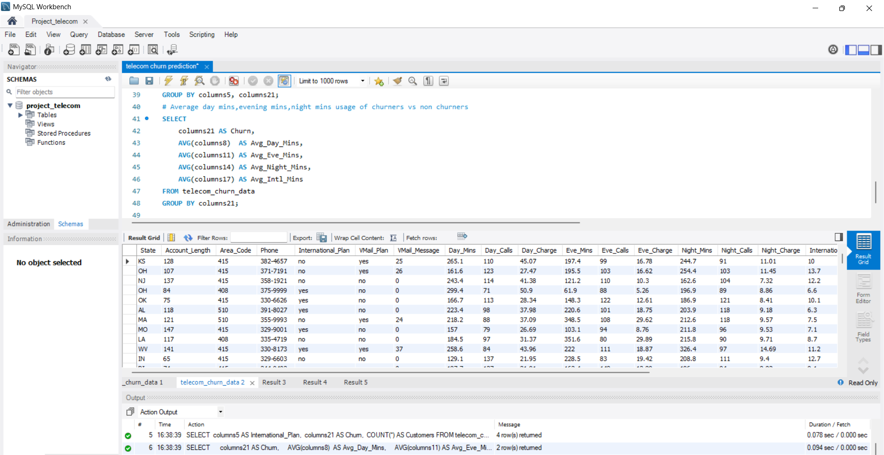
SQL Query

Slide 8
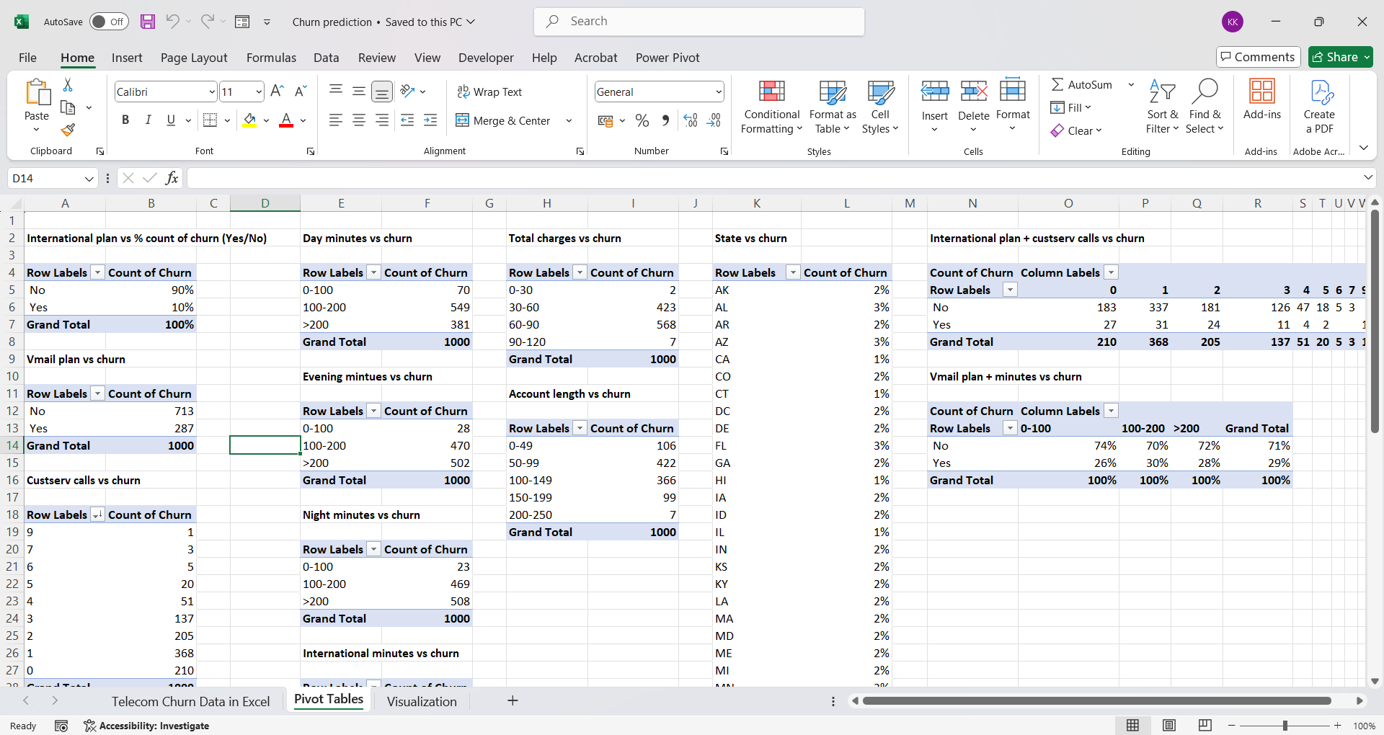
Excel Analysis

Slide 9
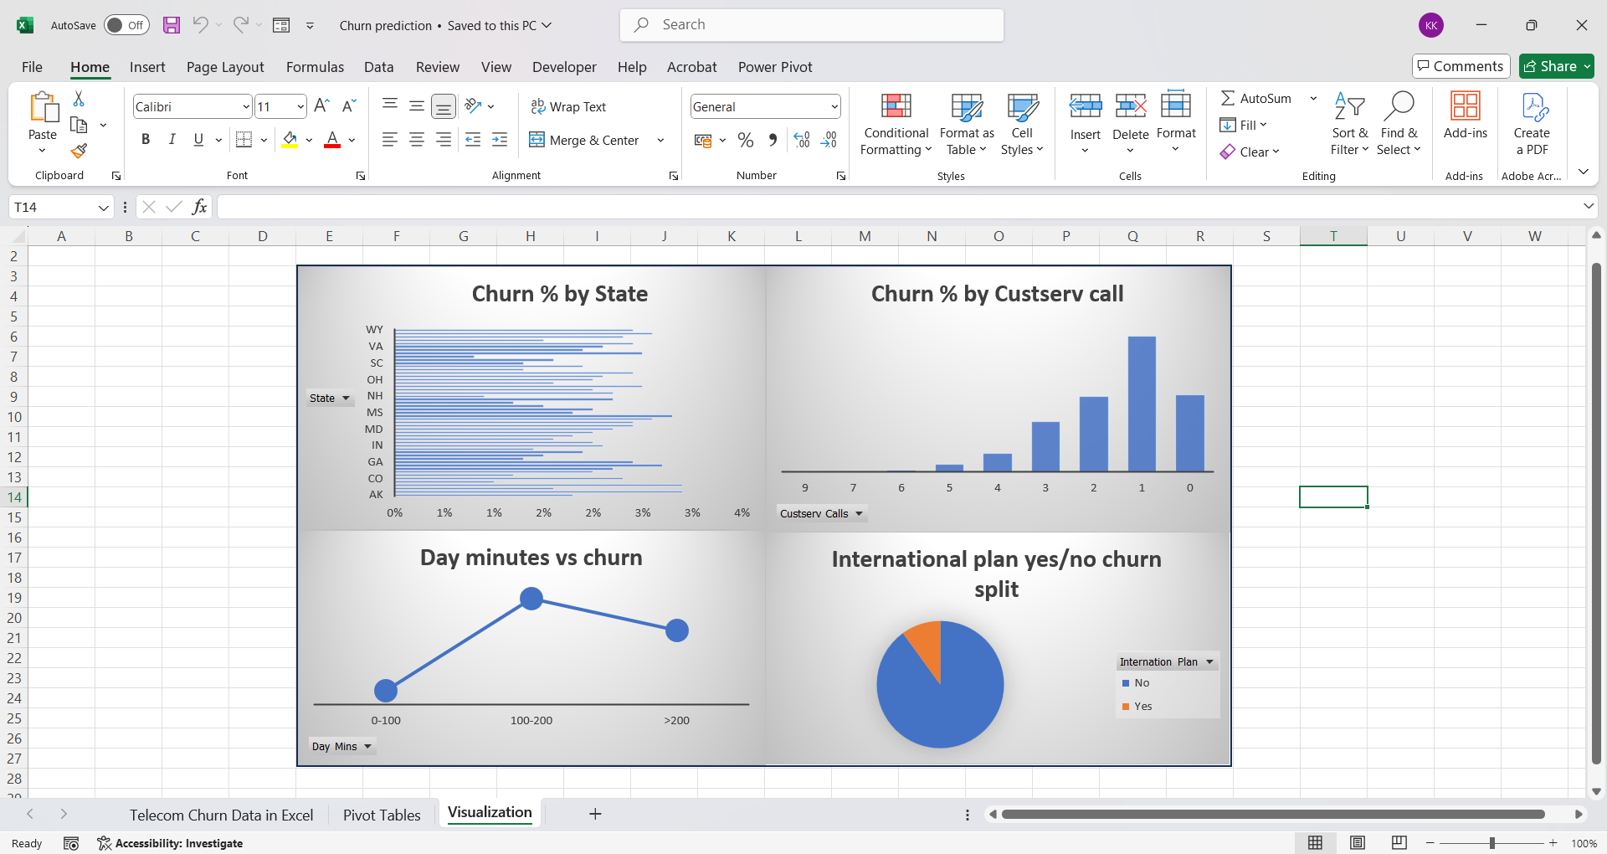

Slide 10
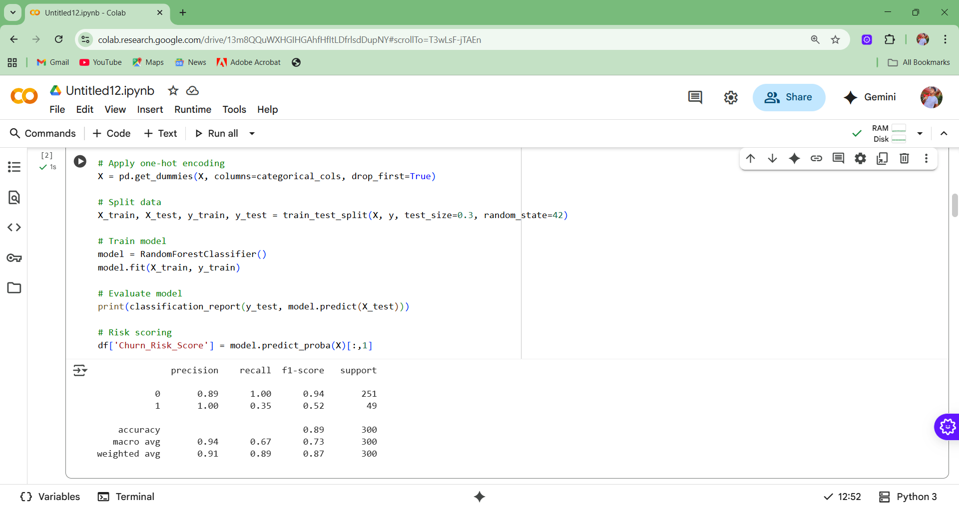
Model Testing

Slide 11
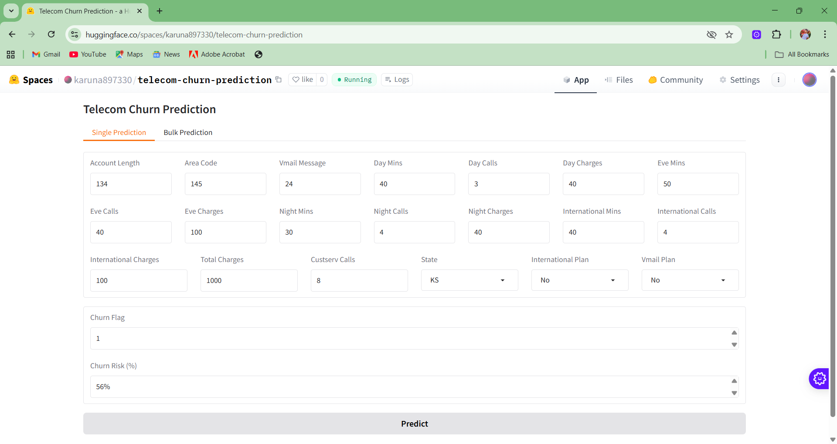
ML Prediction

Slide 12
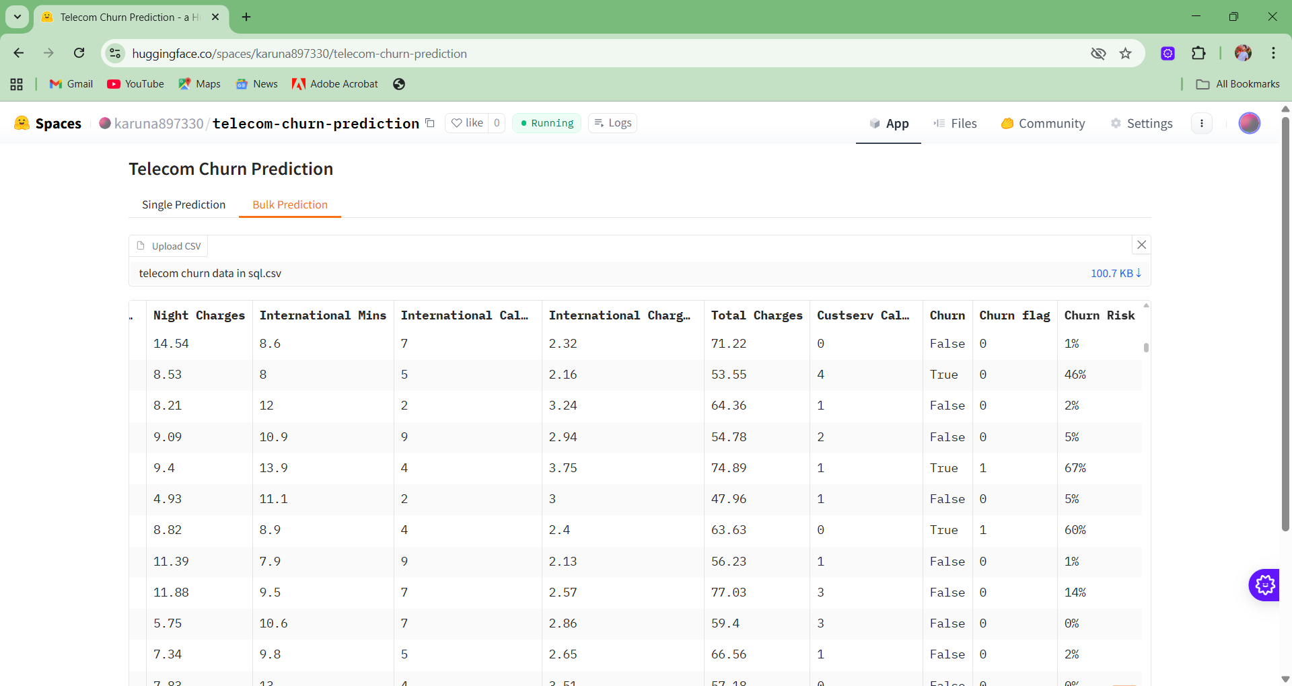

Slide 13
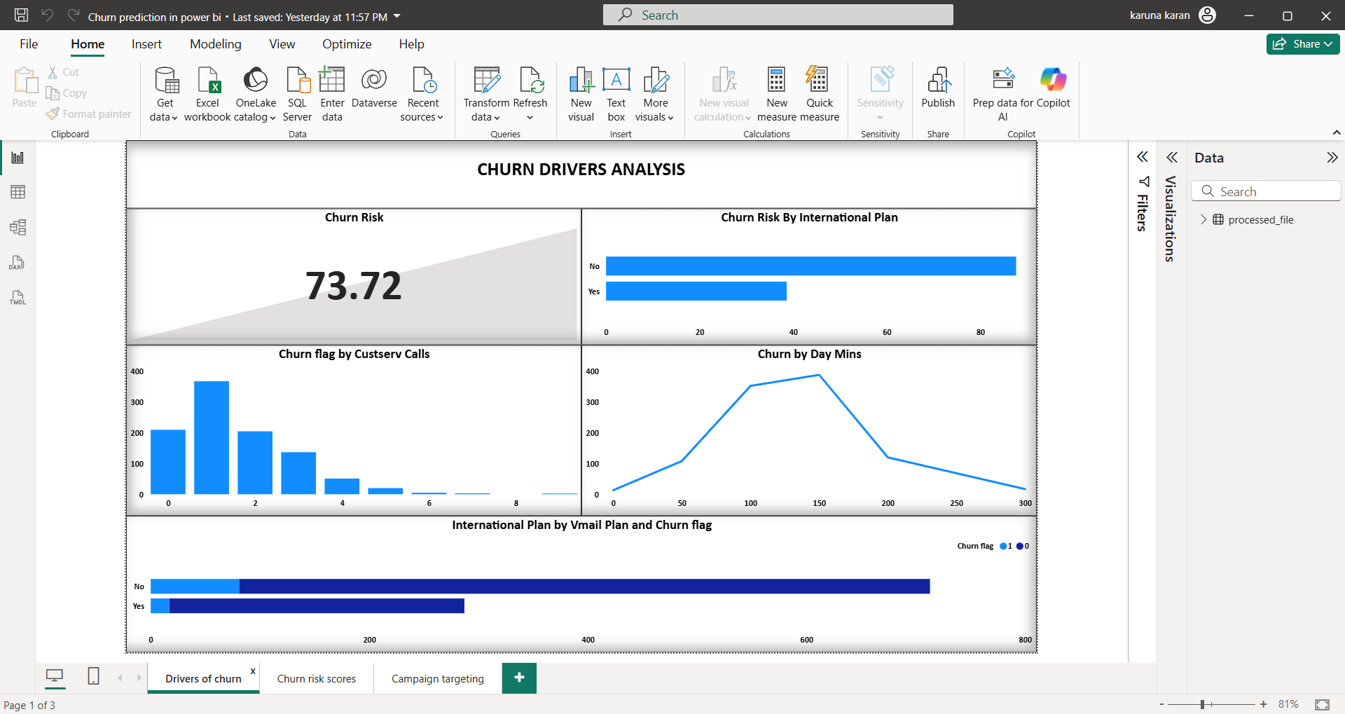
Power BI dashboards

Slide 14
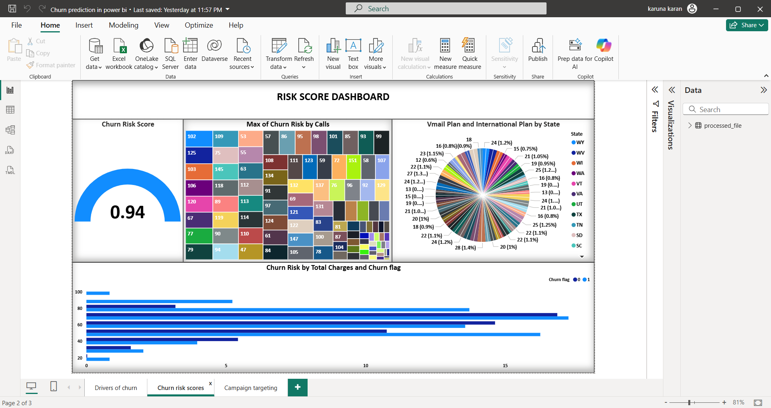

Slide 15
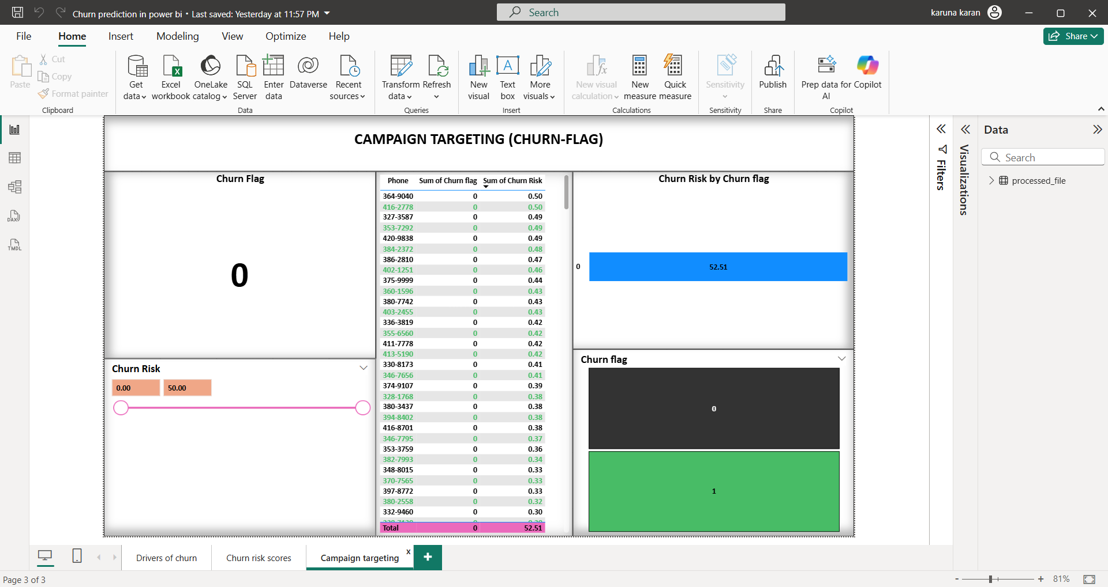

Slide 16
Insights
Customers with International Plan → High churn
>3 customer service calls → high churn risk
Higher Day Minutes & Charges → more churn

Slide 17
Recommendations
Offer retention discounts to high-risk customers.
Improve customer service (resolve within 2 calls).
Create special international call packs.
Send proactive billing/network alerts.
Continuously monitor churn via dashboards.

Slide 18
Conclusion
Best model achieved 85% accuracy.
Identified key churn drivers for actionable strategy.
Delivered BI dashboards + ML app for business use.

Slide 19
Thank you

